Slide 1
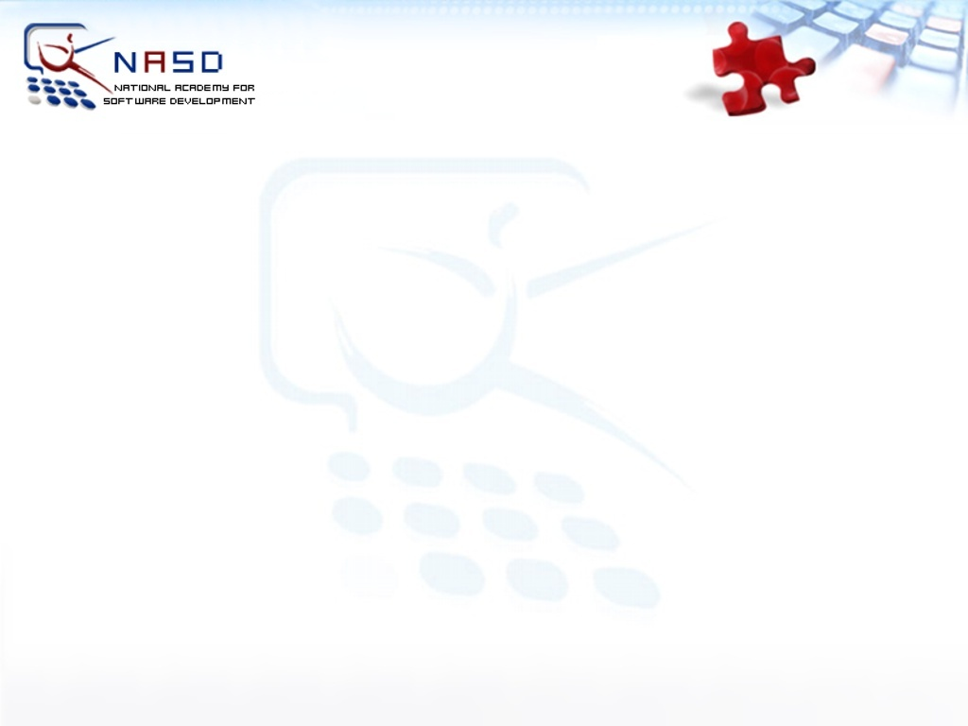
ASP.NET AJAX Basics
Veselin Georgiev
National Academy for Software Development
academy.devbg.org

Slide 2
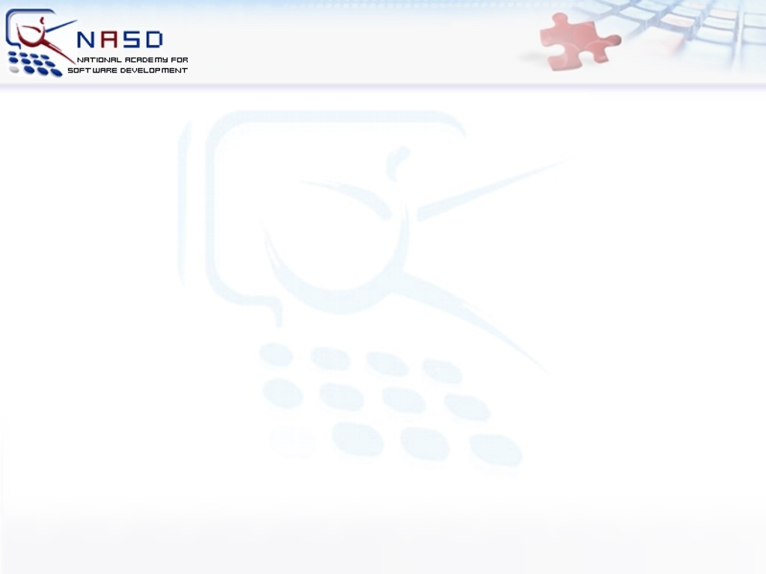
Contents
What is AJAX?
  AJAX Concept
  ASP.NET AJAX Framework
ASP.NET AJAX Server Controls
  ScriptManager, UpdatePanel
  Timer, Update Progress
  Triggers
ASP.NET AJAX Control Toolkit

Slide 3
What is AJAX?

Slide 4
What is AJAX?
AJAX = Asynchronous JavaScript And XML
Approach, not a technology
There are over 50 AJAX frameworks http://www.maxkiesler.com/index.php/weblog/comments/round_up_of_50_ajax_toolkits_and_frameworks
ASP.NET AJAX (former Atlas) is Microsoft’s implementation of AJAX
Combo of several technologies

Slide 5
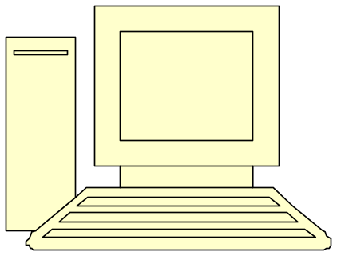
What is AJAX? (2)
AJAX enable you to pass information between a Web browser and Web server without posting to the Web server
Client Web Browser
Server

Slide 6
AJAX Technology
DHTML DOM
  Browser DOM manipulated through JavaScript to dynamically display and interact with information
  CSS stylesheets for formatting
XMLHttpRequest object
  Exchange data asynchronously with the web server
  Any data format will work - HTML fragments, text, XML, etc.
Notes:
<number>##
<footer>*
©2005 Microsoft Corporation. All rights reserved.
This presentation is for informational purposes only. Microsoft makes no warranties, express or implied, in this summary.

Slide 7
What is ASP.NET AJAX
Free framework for quickly creating efficient and interactive Web applications
Set of extensions to ASP.NET
developed by Microsoft for implementing AJAX functionality
Easy-to-use, high-productivity framework
Full integration with server programming model
Notes:
<number>##
<footer>*

Slide 8
What is ASP.NET AJAX (2)
World-class tools for AJAX-style applications
Cross-platform
Works on all modern browsers:
Internet Explorer, Firefox, Safari and Opera
Notes:
<number>##
<footer>*

Slide 9
ASP.NET AJAX Architecture
XHTML, CSS,
JavaScript,
AJAX
Markup
AJAX-enabled
ASP.NET Pages
Web Services
(ASMX or WCF)
AJAX Client Script Library
ASP.NET AJAX Server Extensions
AJAX
Server Controls
App Services Bridge
Controls, Components
Component Model and UI Framework
Asynchronous Communication
Base Class Library
ASP.NET 2.0
Script Core Library
Page Framework,
Server Controls
Application Services
Browser Compatibility
Client Framework and Services
Server Framework
Notes:
<number>##
<footer>*
©2005 Microsoft Corporation. All rights reserved.
This presentation is for informational purposes only. Microsoft makes no warranties, express or implied, in this summary.

Slide 10
ASP.NET AJAX Server Controls

Slide 11
ASP.NET AJAX Server Controls
Easily build rich experiences with ASP.NET
  Application UI and core logic still runs on server
  Avoid need to master JavaScript and asynchronous Programming
Use AJAX techniques to reduce full round trips
Enable incremental page UI updates
  Examples: data navigation and editing, form validation, auto refresh

Slide 12
ASP.NET AJAX Server Controls (2)
Richer interactivity for existing ASP.NET controls
  Enrich the client UI experience of web applications
Examples: auto-completion, drag-and-drop, etc.

Slide 13
ScriptManager Control
<asp:ScriptManager> control
  Manages:
    AJAX components
    Partial page rendering
    Client requests and server responses on ASP.NET server pages.
  Only one manager control per .aspx page
  Automates javascript callbacks

Slide 14
UpdatePanel Control
<asp:UpdatePanel> control
  Easily define “updatable” regions of a page
  Server roundtrips become asynchronous
    <asp:UpdatePanel id=“UpdatePanelDemo” runat=“server”>
    <ContentTemplate>
    <!-- This content can be dynamically updated!->
    <asp:Calendar id=“CalendarDemo”runat=“server”/>
    <ContentTemplate>
    </asp:UpdatePanel>

Slide 15
Triggers
Controls with can cause update of the UpdatePanel’s content
  Can be controls inside or outside the panel
    <asp:UpdatePanel ID="UpdatePanelWithTriggers" runat="server" >
    <Triggers>
    <asp:AsyncPostBackTrigger ControlID="TimerDemo" EventName="Tick" />
    </Triggers>
    </ContentTemplate>
    </ContentTemplate>
    </asp:UpdatePanel>

Slide 16
Timer Control
<asp:Timer> control
  Added as a trigger of an update panel
  Refreshes panel when timer interval expires
    <asp:Timer ID="TimerDemo" runat="Server" Interval="5000" >
    </asp:Timer>

Slide 17
UpdateProgress Control
<asp:UpdateProgress> control
  Shows status while an asynchronous postback is in progress
  Button to cancel the request can be added
    <asp:UpdateProgress ID="UpdateProgressDemo" runat="server">
    <ProgressTemplate>
    Updating ...
    </ProgressTemplate>
    </asp:UpdateProgress>

Slide 18
ASP.NET AJAX Server Controls
Live Demo

Slide 19
Full vs. Partial Postbacks
Live Demo

Slide 20
ASP.NET AJAX Control Toolkit

Slide 21
ASP.NET AJAX Control Toolkit
Collection of samples and components
Ready to go samples
SDK to simplify the creation and re-use of your own custom controls
Full source code, documentation
  CascadingDropDown: Easily link drop downs, complete with asynchronous population and no postbacks!
  CollaspiblePanel: Allows panels on your page to collapse and expand with no code

Slide 22
ASP.NET AJAX Control Toolkit (2)
  ConfirmButton: This extender adds a confirm dialog to any Button, LinkButton, or ImageButton control
  DragPanel: Makes any panel into an object that you can drag around the page!
  ... and many more ...
Landing Page: http://asp.net/ajax/ajaxcontroltoolkit/

Slide 23
ASP.NET AJAX Basics
Questions?

Slide 24
Exercises
Create an AJAX Enabled Web Site which shows Employees among and their Orders in two GridView controls. Use the Northwind sample database. Put the GridView for orders inside an update panel. Add UpdateProgress which shows
an image while loading (simulate slow loading with Thread.Sleep() method).
When the user selects a row in employees GridView, the UpdateProgress must be activated and the panel must be updated
with the orders of the selected Employee.

Slide 25
Exercises (2)
Add Timer with interval of 1 seconds and place an date to indicate current time.

